Slide 1

Structural variation detection and interpretation
Slides by
Thomas Keane,
EVA, EGA, ENA archive infrastructure team, EMBL-EBI
@drtkeane
E: tk2@ebi.ac.uk
Presented and modified by
Eric T. Dawson
Bioinformatics Scientist (Nvidia)
@erictdawson

Slide 2
Genomic structural variation
Any form of rearrangement of chromosome structure (usually longer than 50bp)
Contribute to genetic diversity and evolution, new gene formation, gene function, phenotypic diversity, rare variants of large effect
Frequent causes of disease
Referred to as genomic disorders
Mendelian diseases or complex traits such as behaviors
E.g. increase in gene dosage due to increase in copy number
Several type or categories of structural variation
Insertions, deletions, copy number changes, inversions, translocations
Complex events contain combinations of these in close proximity
Breakpoint: as a pair of bases that are adjacent in an experimentally sequenced ‘sample’ genome but not in the reference genome
Many experimental techniques to detect SVs

Slide 3
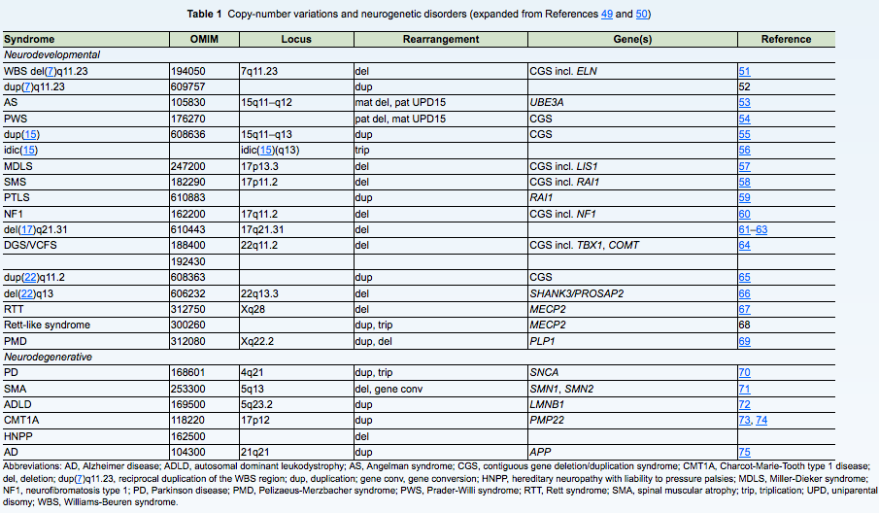
SVs and human disease
Stankiewicz and Lupski (2010) Ann. Rev. Med.

Slide 4
Methods for detecting SVs
Chromosome banding: chromosomes are prepared from dividing cells, stained, and viewed with a microscope. Large deletions, duplications, and translocations are detected if the banding pattern or chromosome structure is altered.
Fluorescence in situ hybridization (FISH): fluorescent-labeled DNA probes hybridize to metaphase or interphase cells to visualize a locus on a chromosome and determine copy number. FISH can determine the location of chromosomal segments identified by microarray, NGS, and WGS.
Microarray: array comparative genome hybridisation (array CGH) detects copy-number differences between abnormal and reference genomes. SNP arrays detect changes in copy-number and allelic ratios. CNV location and SV organization are not determined by microarray methods.
Whole-genome sequencing (WGS): Breakpoints of CNV and copy-neutral SV are detectable by paired-end reads that have discordant mappings to the reference genome.
Mate-pair sequencing: whereas standard NGS methods sequence the ends of 300-500 bp DNA fragments, mate-pair or jumping libraries sequence the ends of DNA fragments that are several kb in length. These large-fragment mate-pair libraries increase the likelihood of detecting SV that has breakpoints within interspersed repeats.
Third generation sequencing: sequencing long molecules of DNA (several kbp) and subsequent alignment to a reference genome to detect SVs
Weckselblatt and Rudd (2015) Trends in Genetics

Slide 5
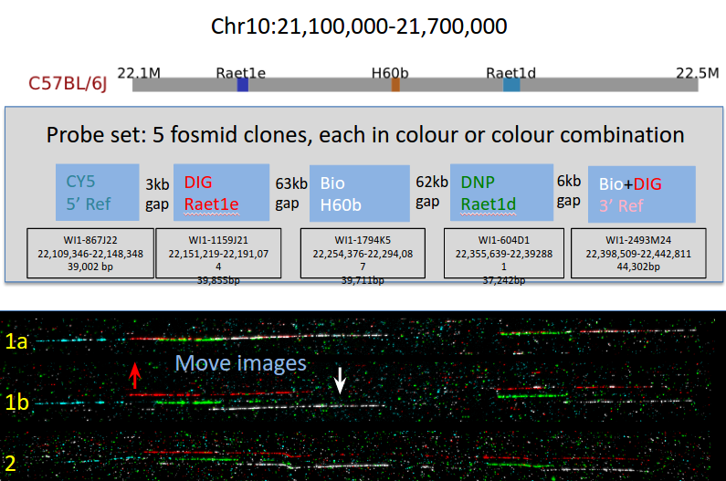
Fiber FISH

Slide 6
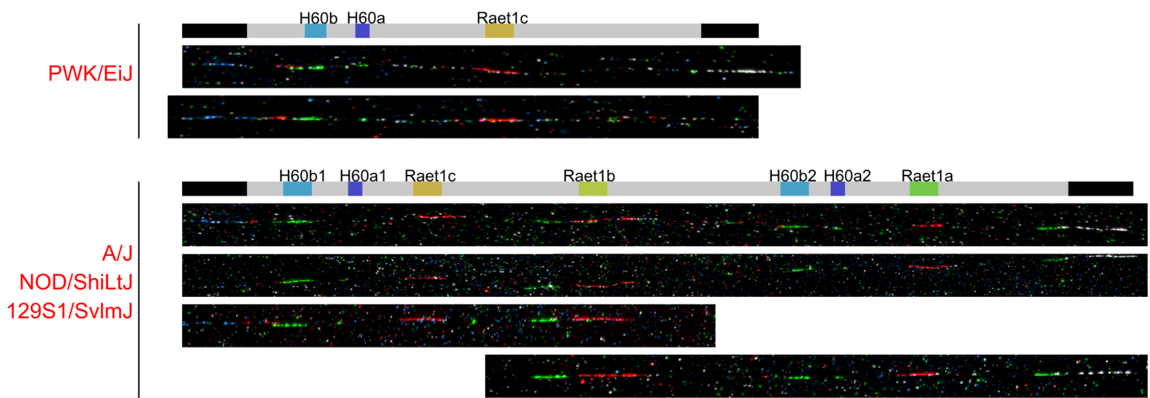
Fiber FISH

Slide 7
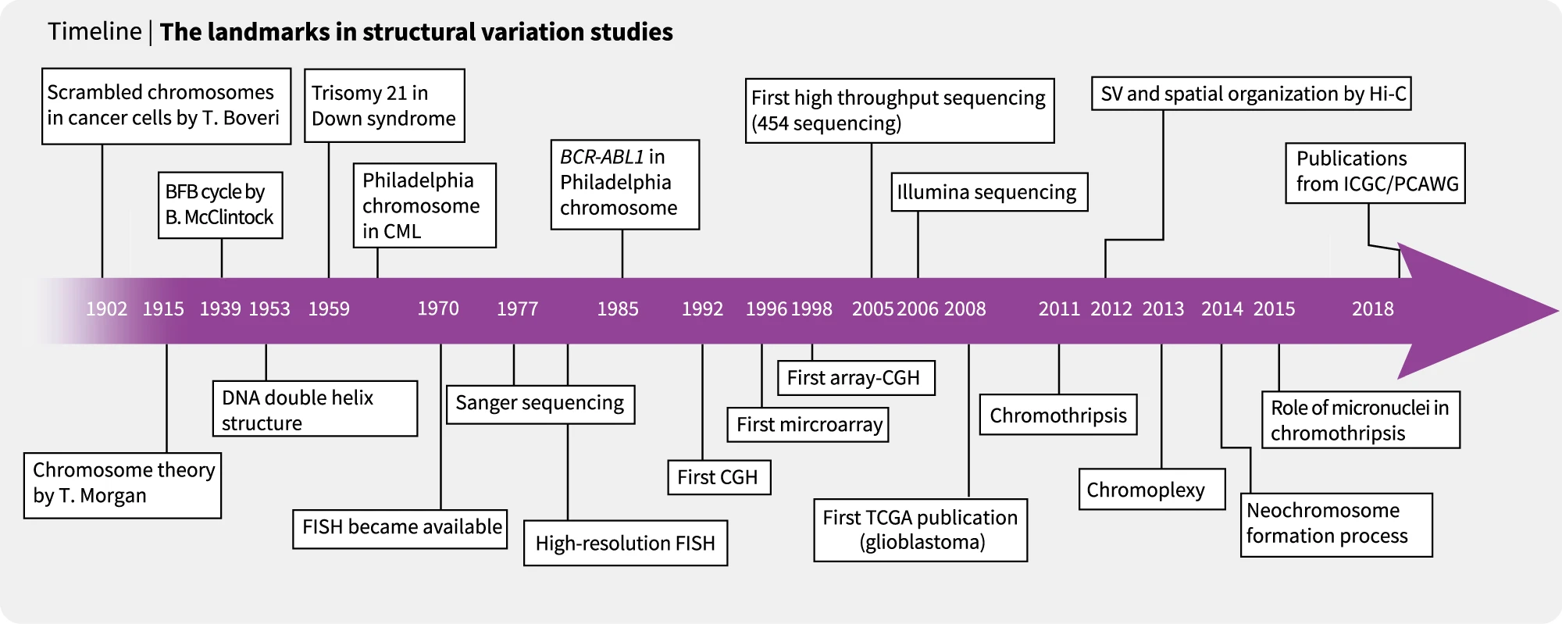
Methods for detecting SVs
From: https://www.nature.com/articles/s12276-018-0112-3

Slide 8
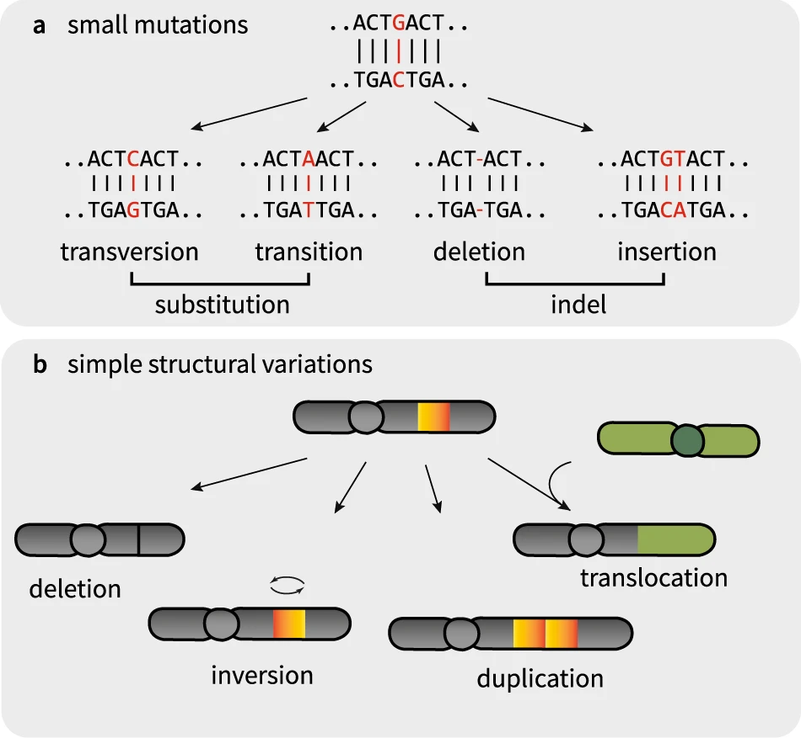
Types of structural variants
Again: >50bp in size
Remember the four basic types
From: https://www.nature.com/articles/s12276-018-0112-3

Slide 9
Quiz
What are the four kinds of structural variation?

Slide 10
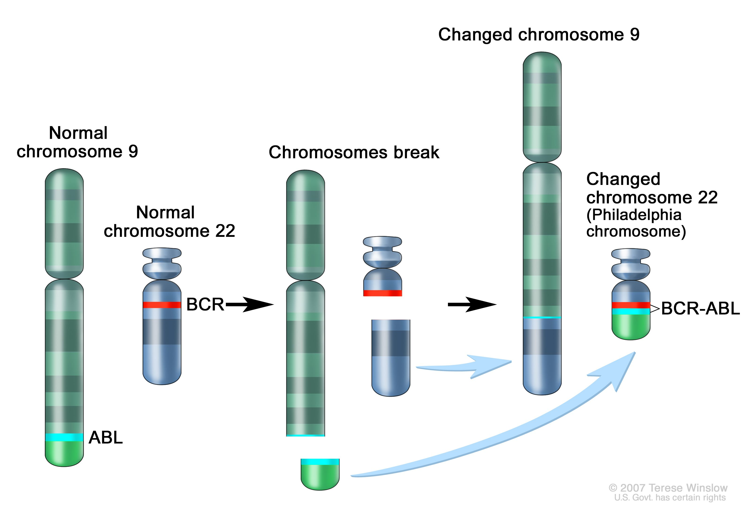
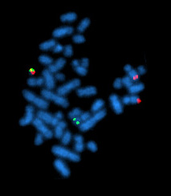
Example of Gene Fusion by SV + Detection
Philadelphia Chromosome (BCR-ABL)

Slide 11
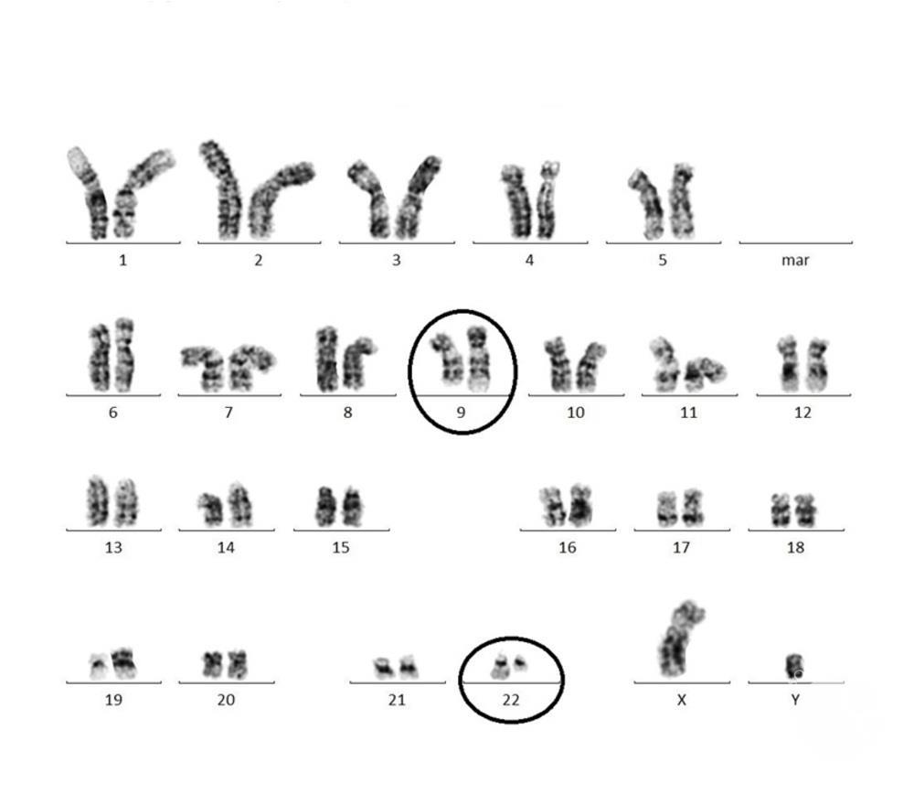
Philadephia Chromosome (by Karyotype)

Slide 12
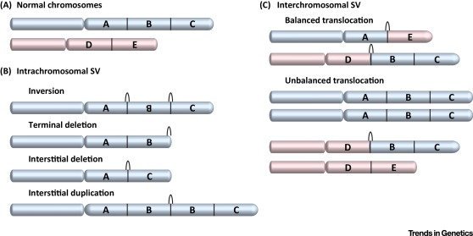
SV types
(A) Two nonhomologous chromosomes shown in blue and pink. Segments are labeled with letters A-E. Black arches indicate structural variation (SV) breakpoint junctions. (B) Intrachromosomal rearrangements include inversions, interstitial and terminal deletions, and interstitial duplications. (C) Simple translocations between two different chromosome ends. Balanced translocations do not result in copy-number variation (CNV), but unbalanced translocations have partial monosomy (segment E) and partial trisomy (segments B,C).
Weckselblatt and Rudd (2015) Trends in Genetics

Slide 13
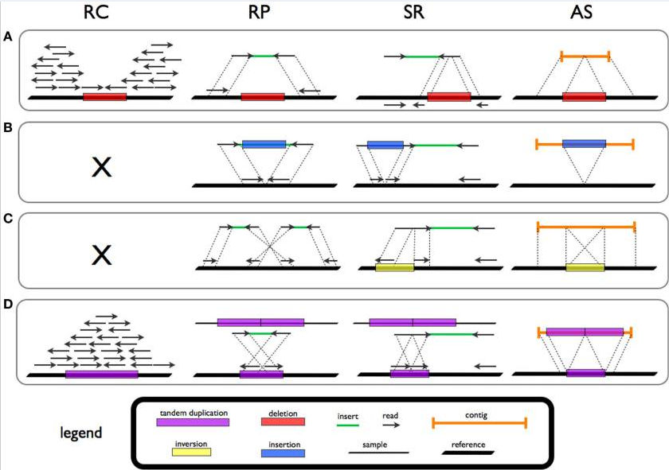
SV Signatures are written into read data
Deletion
Insertion
Inversion
Duplication

Slide 14
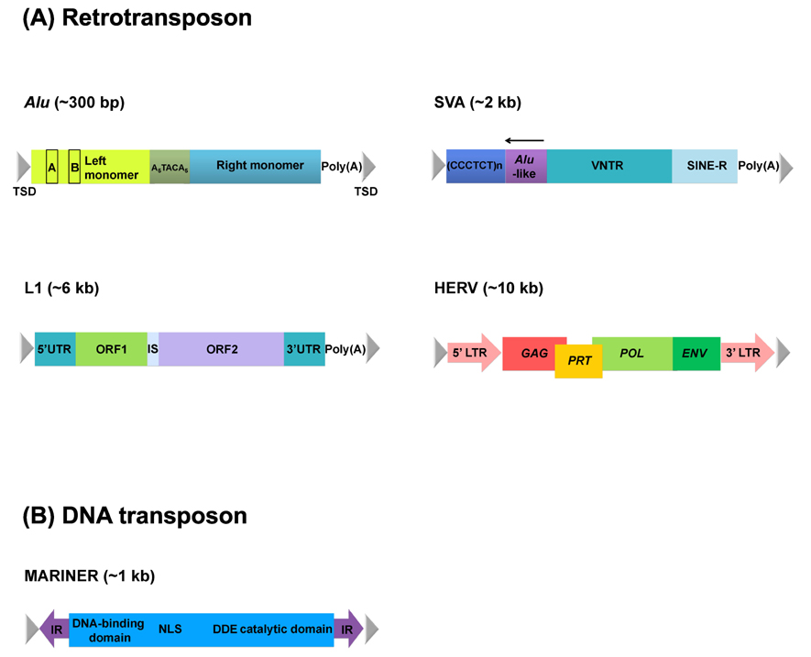
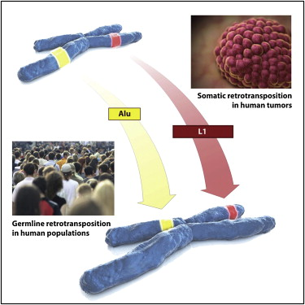
Retrotransposition
Transposons are segments of DNA that can move within the genome
A minimal ‘genome’ - ability to replicate and change location
Relics of ancient viral infections
Dominate landscape of mammalian genomes
38-45% of rodent and primate genomes
Genome size proportional to number of TEs
Class 1 (RNA intermediate) and 2 (DNA intermediate)
Potent genetic mutagens
Disrupt expression of genes
Genome reorganisation and evolution
Transduction of flanking sequence
Species specific families
Human: Alu, L1, SVA, MLE (mariner-like)
Human endogenous retrovirus
Mouse: SINE, LINE, ERV
Many other families in other species
Genomics Inform. 2012 Dec;10(4):226-233
Notes:
Structures of transposable elements. These elements could be categorized into retrotransposons (Alu, long interspersed element [LINE], and human endogenous retrovirus [HERV]) (A) and DNA transposons (e.g., MARINER) (B) based on their manner of mobilization. In addition, autonomous elements (e.g., HERV and LINE) have coding genes responsible for their own mobilization but also other nonautonomous elements (e.g., Alu and short interspersed element/variable number of tandem repeats/Alu [SVA]). Alu consists of two monomers separated by an A-rich connector, one of which, the left monomer, includes internal RNA polymerase III promoter (A and B boxes). Full-length of LINE is ~6 kb and has open reading frames (ORFs) encoding RNA-binding protein, endonuclease, and reverse-transcriptase, which are flanked by untraslated regions (UTRs). ORF1 and ORF2 are separated by an ~60-bp-long intergenic spacer (IS). SVA contains a (CCCTCT)n hexamer, Alu-like sequences, variable number of tandem repeat (VNTR), and short interspersed element-R (SINE-R). An arrow on Alu-like sequences indicates the direction of Alu. HERV has gag, prt, pol, and env genes flanked by a long terminal repeat (LTR), which encodes capsid protein, protease, polymerase, and envelop protein, respectively, used in viral infection. As an example of DNA transposon, mariner has a gene encoding transposase with a DNA-binding domain and catalytic domain flanked by an inverted repeat (IR). All elements are flanked by target site duplication (TSD) through integration. DDE, the conserved DDE sequence of the mariner transposase; NLS, nuclear localization signal.

Slide 15
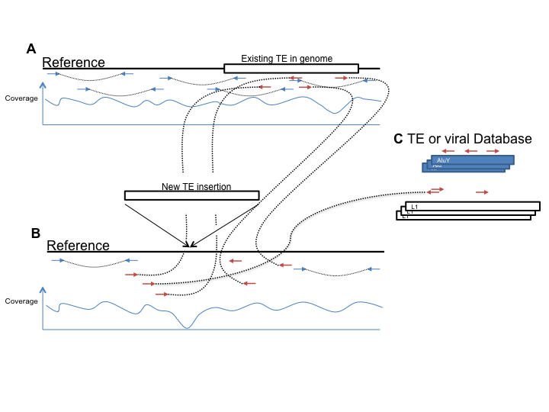
NGS and non-reference retrotransposition events

Slide 16
Quiz!
What are two examples of retrotransposon elements?

Slide 17
Detecting SVs in short read data
General sources of evidence:
Read pairing / pair orientation
Split reads
Read count (depth)
Assembly

Slide 18
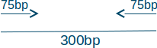
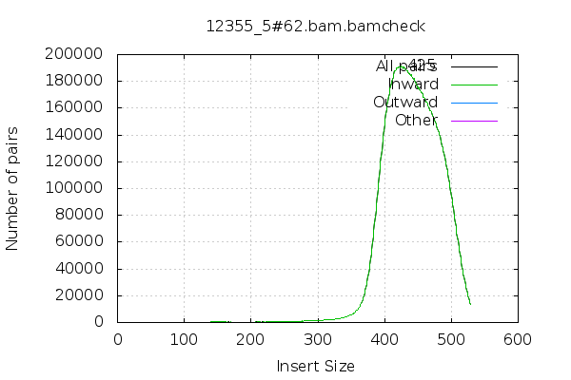
Sources of evidence 1: Read pairs
Sensitive to several types of structural variations (SVs)
Large Insertions/deletions
Inversions
Translocations
Read pair information used to detect these events
Paired end sequencing of either end of DNA fragment
Observe deviations from the expected fragment size
Presence/absence of read pairs

Slide 19
Sources of evidence 1: Read pairs
Several types of structural variations (SVs)
Large Insertions/deletions
Inversions
Translocations
Read pair information used to detect these events
Paired end sequencing of either end of DNA fragment
Observe deviations from the expected fragment size
Presence/absence of read pairs
200bp

Slide 20
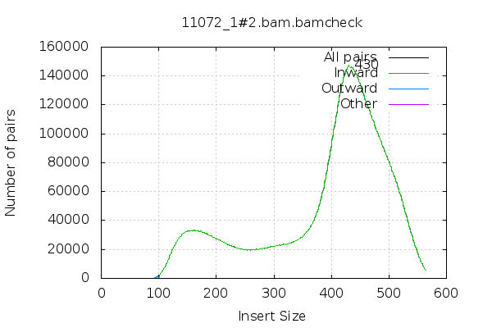
Fragment Size QC
What’s weird about the fragment size plot on the right?

Slide 21
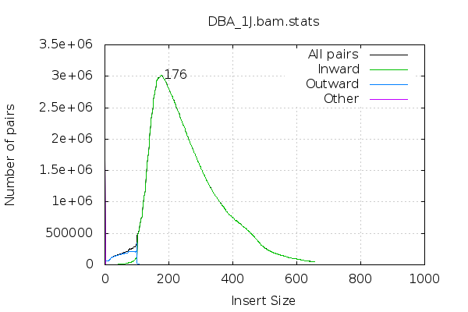
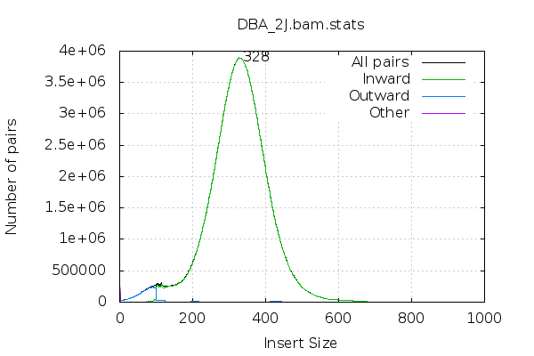
Fragment size again
What’s the difference between these two (note, the annotated number is the median, but what are some other statistics that might be informative)? What is the effect of this difference?

Slide 22
Fragment size again
DBA/1J
DBA/2J
DBA/1J fragment size distribution has larger range (~450bp) vs. DBA/2J (~250bp)
SV caller only considers read pairs discordant if they fall outside of the extremes of the fragment size distribution
Observed in DBA/1J that we had lower sensitivity to call SVs in the 300-500bp range compared to DBA/2J

Slide 23
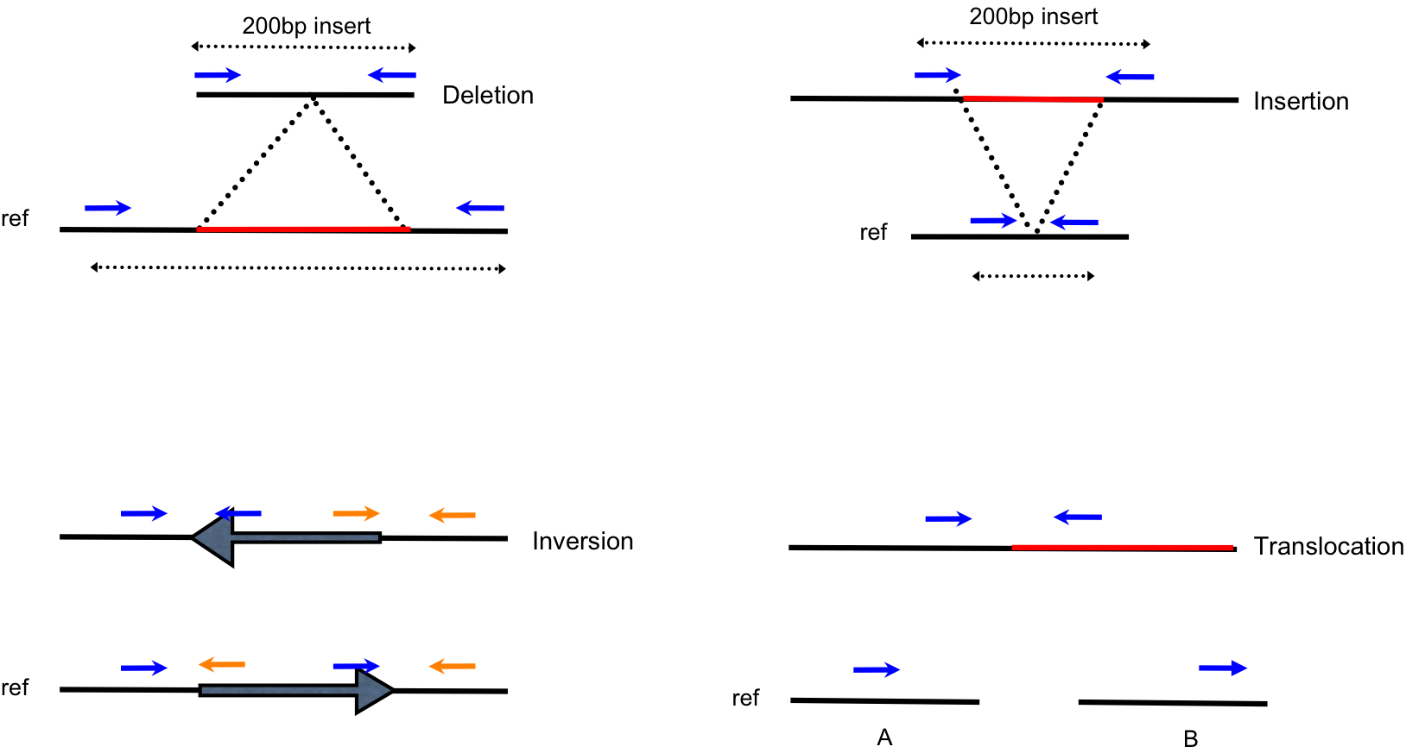
SV Signatures are written in paired end data
Notes:
Signals of structural variation appear as abnormal mapping in our paired end reads

Slide 24
Quiz – read orientation
Reads
Reference
If my reads are aligned like this (F1F2), what kind of SV might this support?
Notes:
It’s an inversion

Slide 25
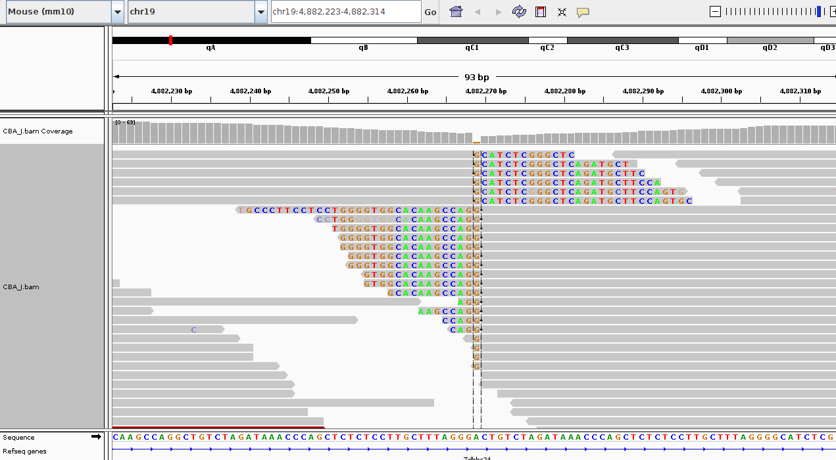
Sources of evidence 2: Split reads
A split-read alignment is a single DNA fragment that spans a breakpoint and therefore does not contiguously align to the reference genome
Errors in the sequencing and alignment processes creates some ambiguity in the exact location of the breakpoint associated with a split-read alignment
breakpoint
Right click - view mismatch bases
View - preferences - alignments - show soft clipped bases

Slide 26
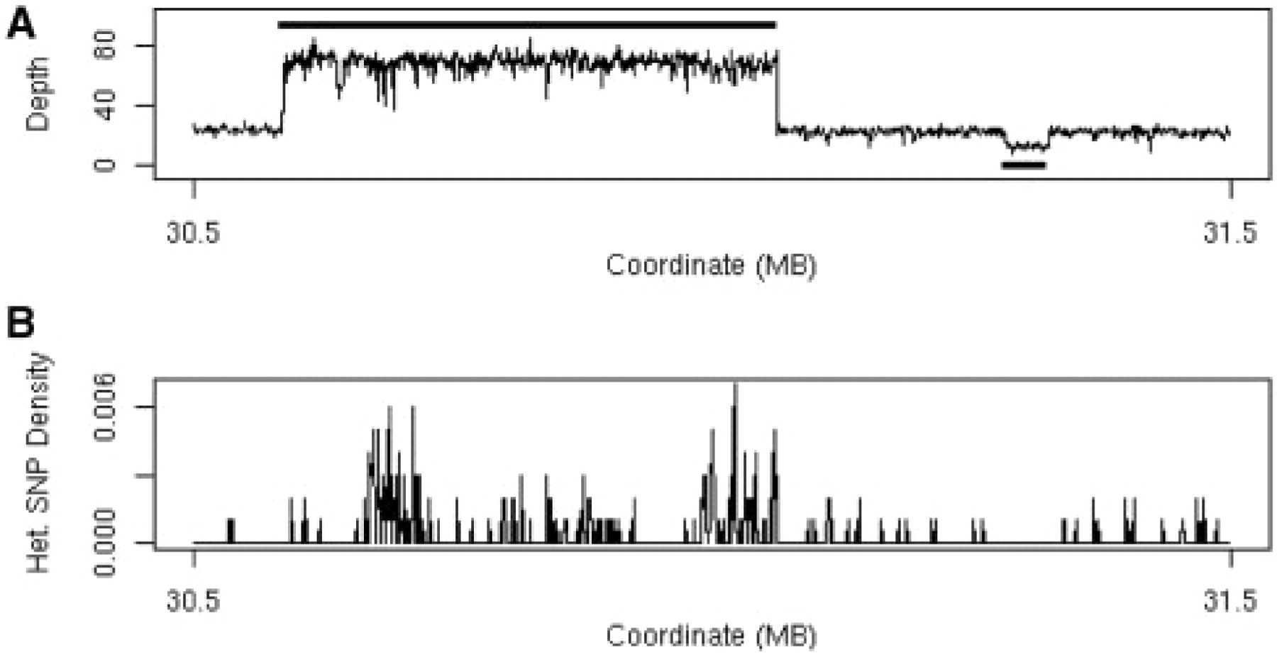
Sources of evidence 3: Read depth
Fig. 1. (A) Plot of sequencing depth across a one megabase region of A/J chromosome 17 clearly shows both a region of 3-fold increased copy number (30.6–31.1 Mb) and a region of decreased copy number (at 31.3 Mb). The solid black line above the depth plot indicates the called copy number gain and the solid black line below the plot indicates the called copy number loss. (B) Plot of the heterozygous SNP rate for the same region showing the high number of apparent heterozygous SNPs associated with the copy number gain.
Simpson et al. (2009) Bioinformatics

Slide 27
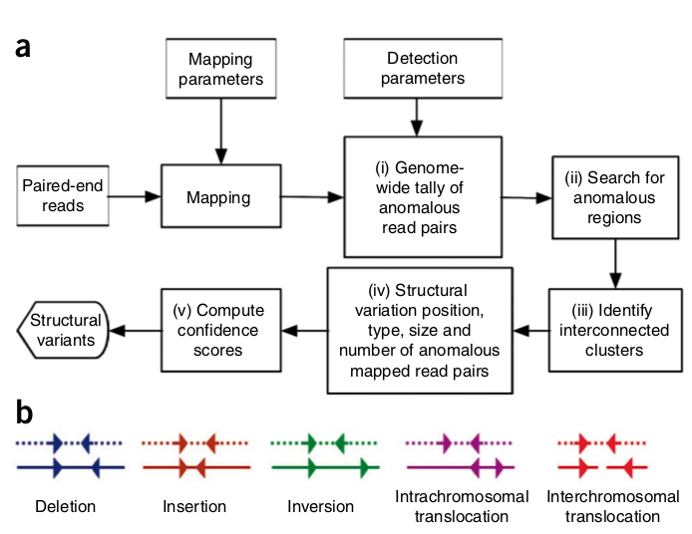
Breakdancer (uses just Read Pairs)
Identifies deletions, insertions, inversions and intrachromosomal and interchromosomal translocations
Input: BAM file
Algorithm:
Analyse a subset of reads from each sequencing library (determine mean and standard deviation of fragment size)
Walk along each chromosome to identify all of the anomalous read pairs (a). Identify interconnected clusters.
Assign anomalous clusters into categories (b)
Output
Text with one SV event per line
Filter by: minimum number of reads, quality score, type of SV
Chen et al. (2009) Nature methods

Slide 28
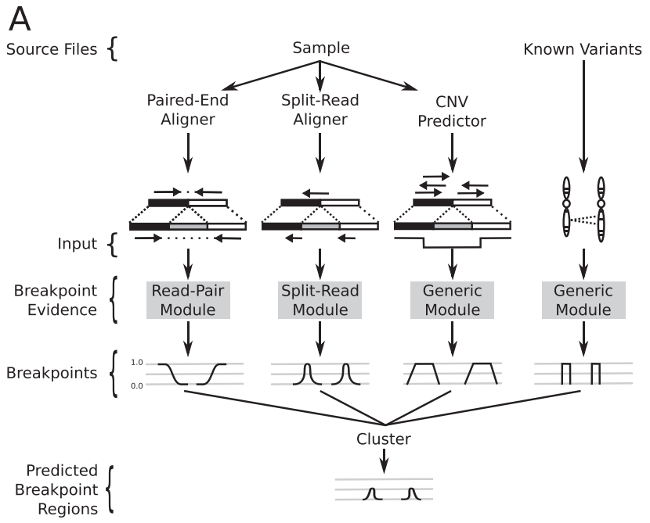
Lumpy (Read pairs + split reads + depth)
Any number of alignment signals can be integrated into a single discovery process
Read pairs, split-reads, depth, user supplied evidence
Distinct modules that map signals from each alignment evidence type to the common probability interval pair.
Evidence from the different alignment signals is mapped to breakpoint intervals, overlapping intervals are clustered and the probabilities are integrated
Layer et al. (2014) Genome Biology

Slide 29
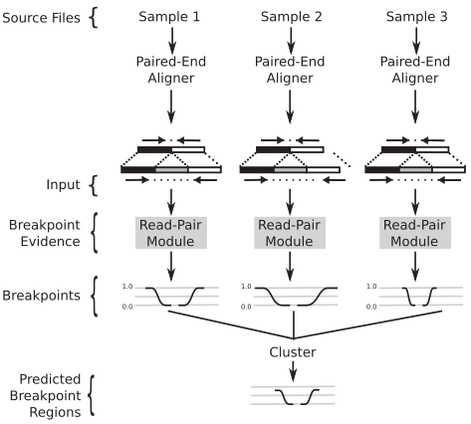
Lumpy: multi-signal and multi-sample workflows
Layer et al. (2014) Genome Biology

Slide 30
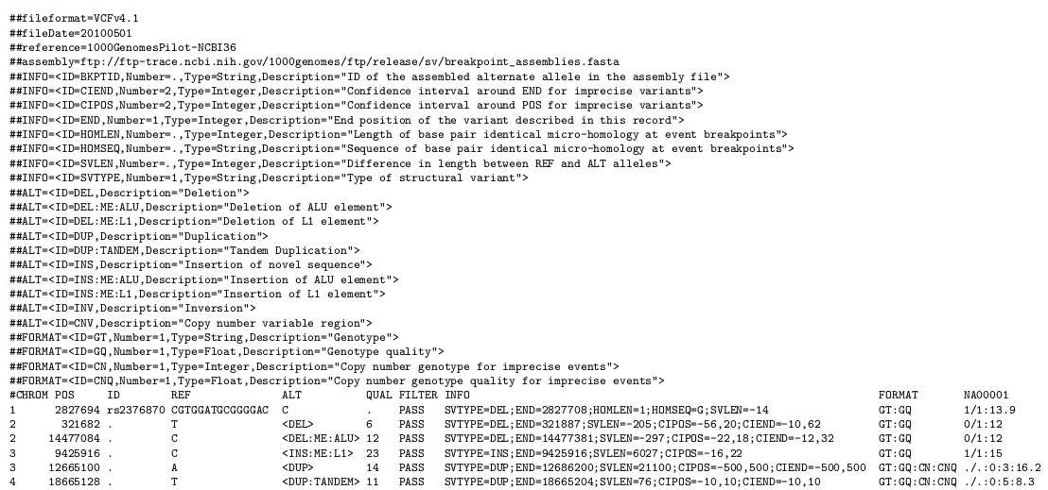
VCF for SVs

Slide 31
VCF for SVs

Slide 32
VCF for SVs

Slide 33
VCF for SVs
What does the CIEND info tag describe?
How many different types of insertions can be described from the ALT tags?
The first and second entries are both deletions, but what is the difference between them?

Slide 34
VCF for SVs
Can you write out the VCF entry for a Alu insertion at chromosome 7, position 125467, of length 258bp, and a breakpoint confidence interval of +/20bp with one sample that is heterozygous for the insertion and has genotype quality of 40?

Slide 35
SV Visualisation
Structural variation visualisation can be more challenging than SNPs and indels
Inspect several hundred base pairs or multiple kbp
Analyse complicated read pair patterns to determine type of SV and sources of error
Look for soft clipped bases for breakpoint accuracy
Many NGS visualisation software packages exist
IGV from Broad institute is a popular and easy to use visualisation software
Requires BAM file and fasta file of the reference genome
Viewing settings need to be tailored for the type of SV being visualised (see notes below each screenshot)

Slide 36
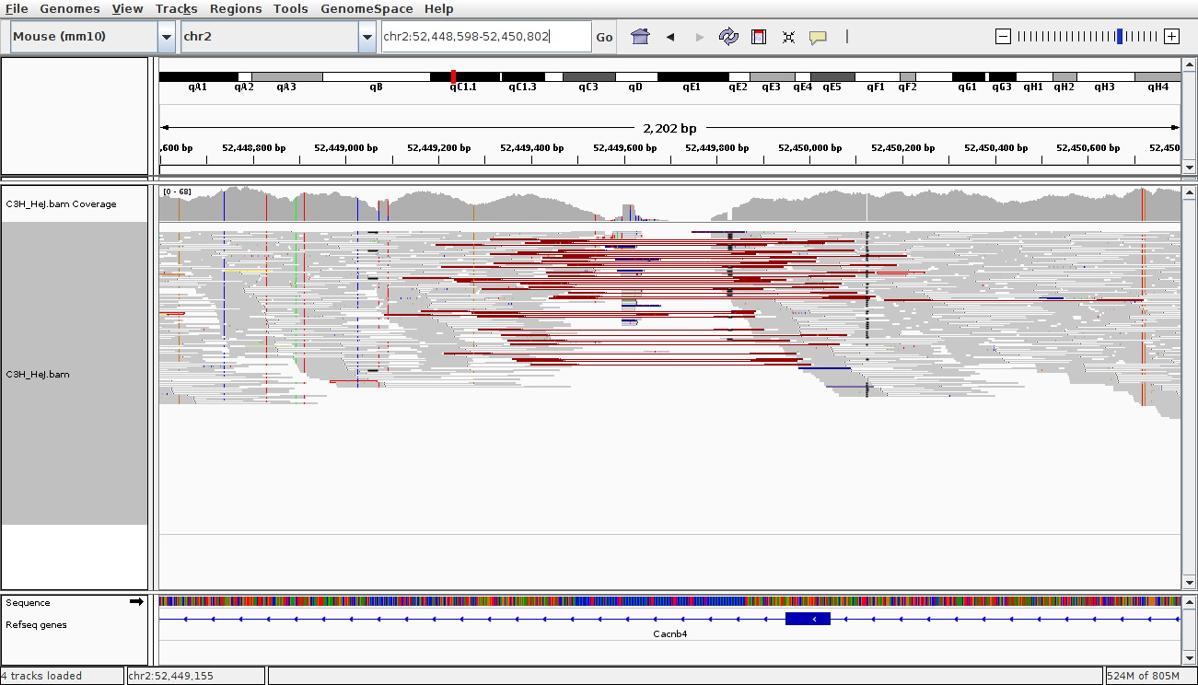
IGV - Deletion
Right click - Squished

Slide 37
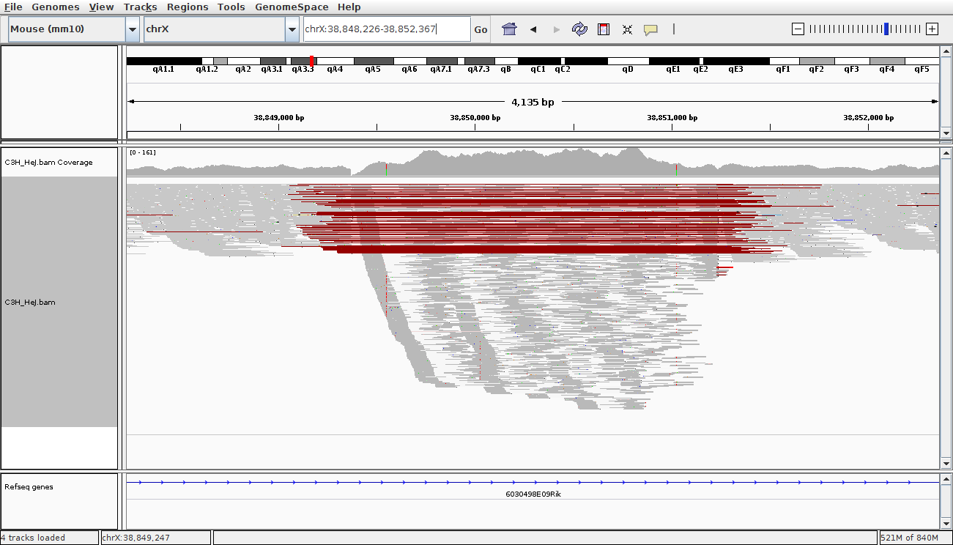
IGV - Repeat element deletion
What indicates this is a repeat element deletion?
Right click - Squished

Slide 38
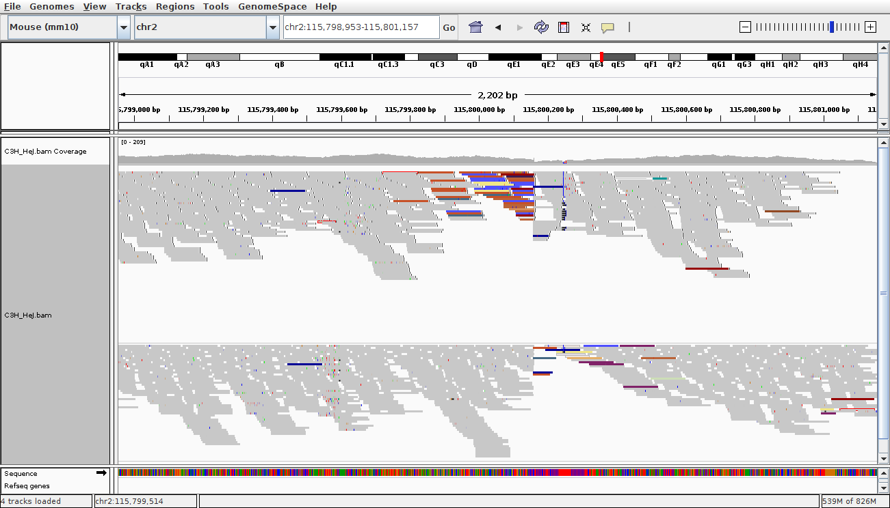
IGV - Insertion
Right click - group alignments by 'read strand'

Slide 39
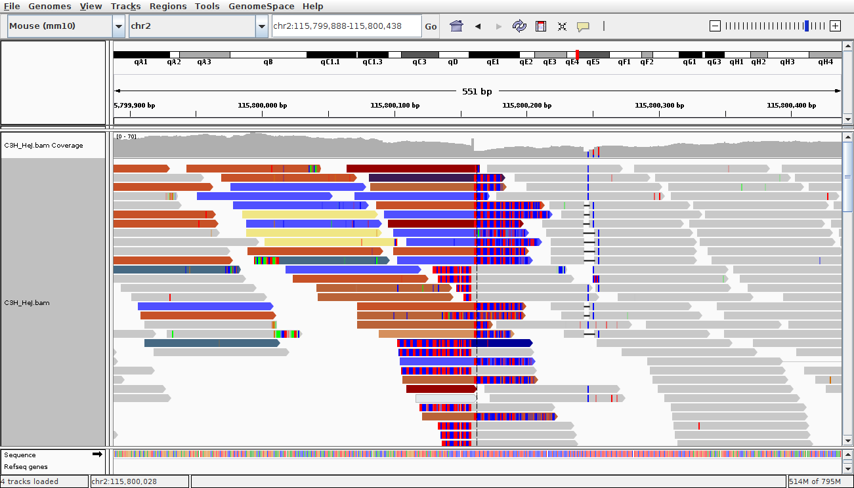
IGV - Insertion (zoomed)
Right click - view mismatch bases
View - preferences - alignments - show soft clipped bases

Slide 40
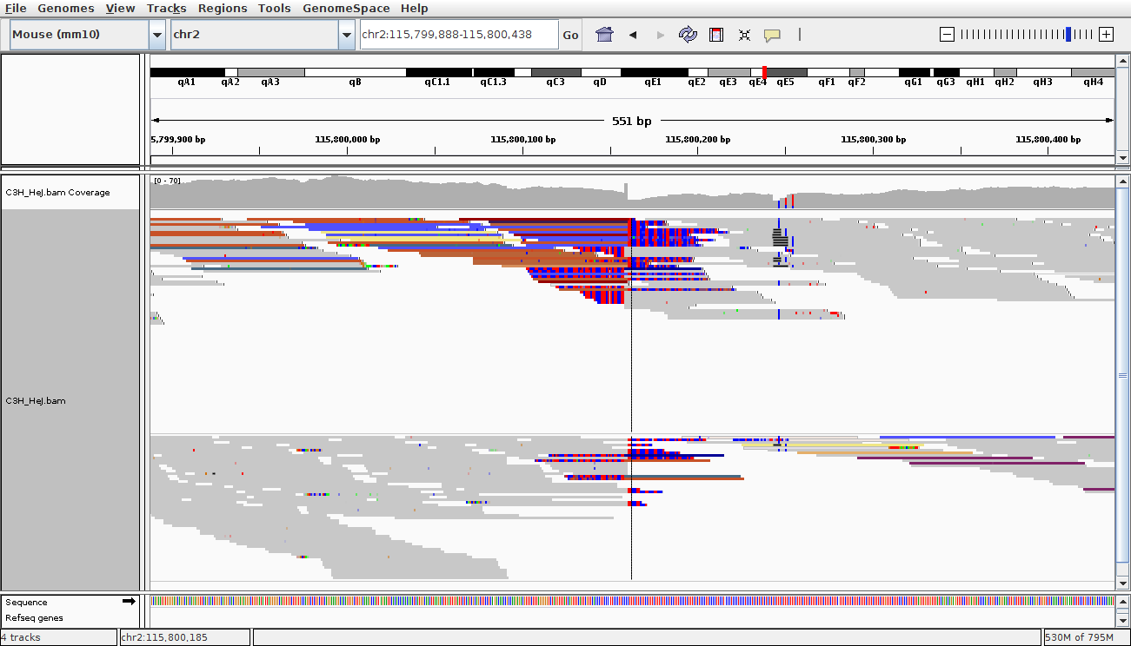
IGV - Insertion (zoomed)
Right click - Squished

Slide 41
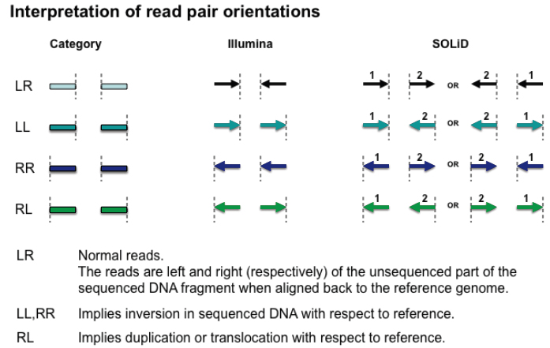
Read pairing information in IGV

Slide 42
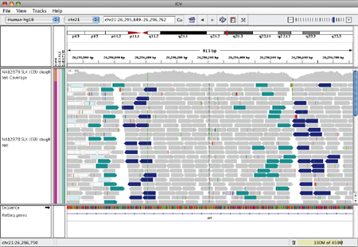
What kind of Structural Variant do we think this is?

Slide 43
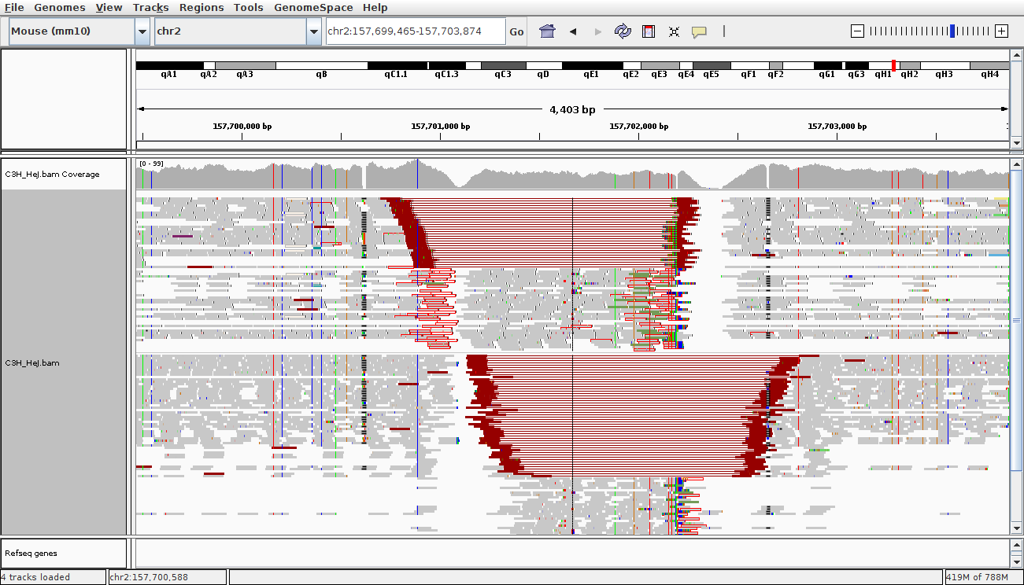
IGV - what is this?
Right click - group alignments by - read strand
Red lines are reads that are aligned further apart than expected
Notes:
Inverted deletion

Slide 44
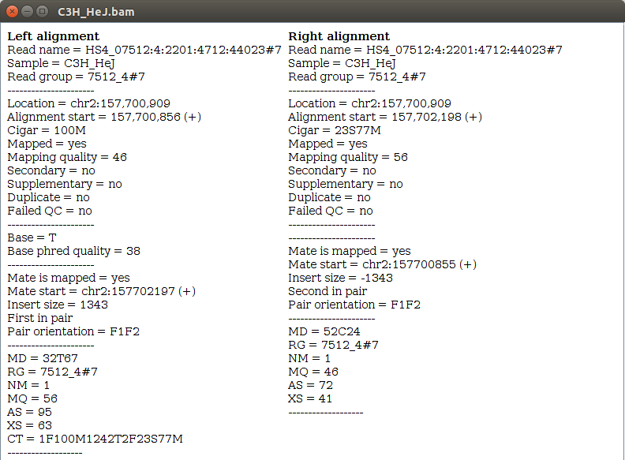
IGV - mouse over or click on a red read

Slide 45


SVs and long read sequencing
Single molecule sequencing of large DNA fragments
Platforms: Oxford nanopore and Pacific Biosciences
Read lengths 10-20Kbp routinely (record: 4 Megabases)
Longer than most common transposable element repeats
What does it mean for SV detection? Span both breakpoints with single read
Some new challenges
- Reads are error prone, 5-20% error
- Challenging to align the reads correctly

Slide 46
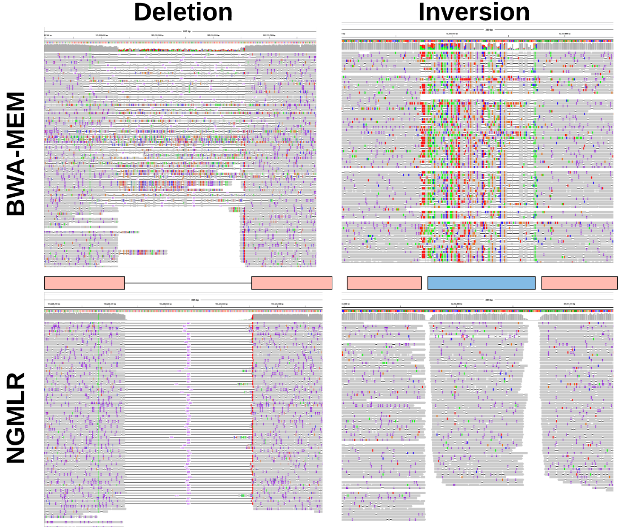
Alignment challenges
BWA MEM was designed for short reads (where we expect long exact matches between reads and reference) – but this is less common in long reads with higher error rates.
What’s wrong with these alignments?

Slide 47
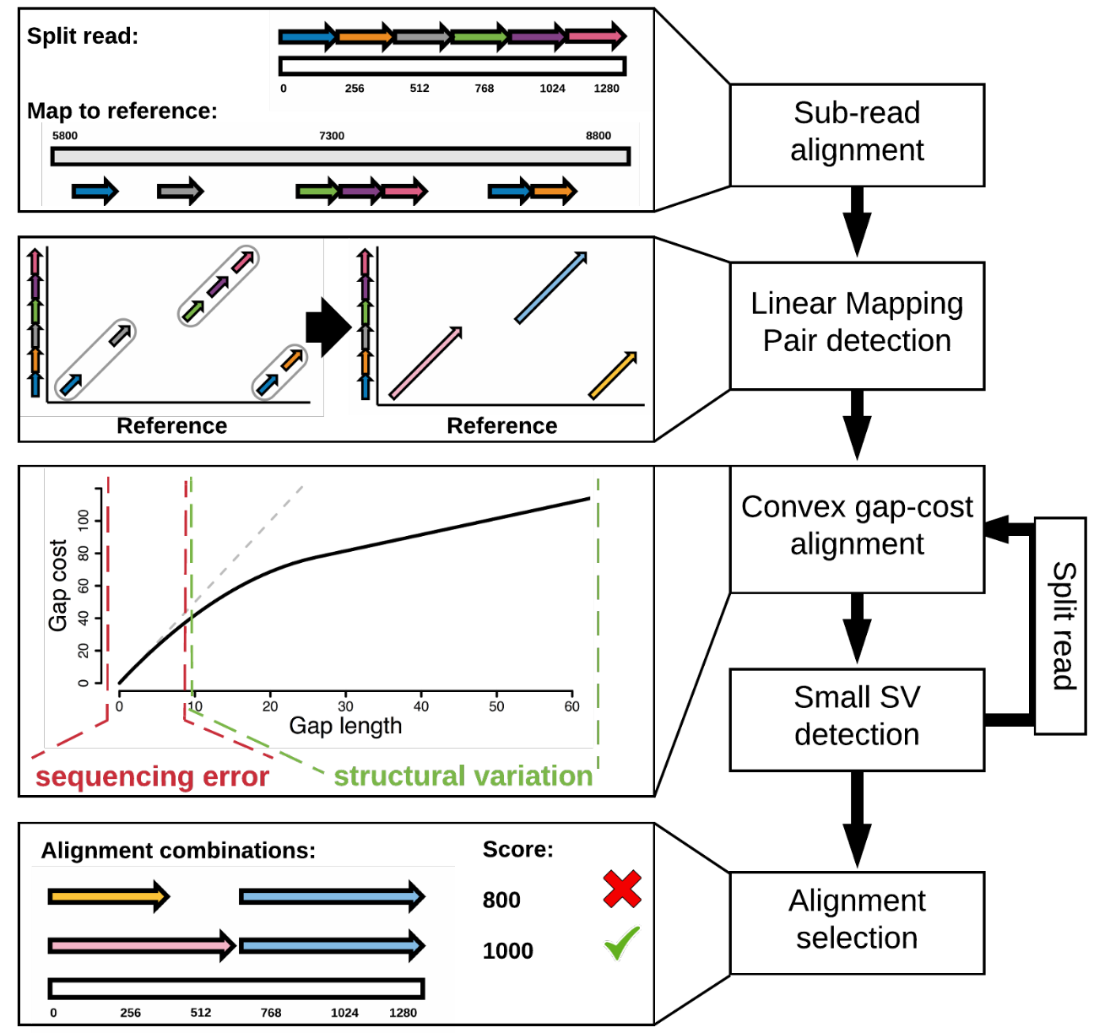
CoNvex Gap-cost alignMents for Long Reads (NGMLR)
NGMLR - aligner specifically designed for long reads
Convex scoring model
Extending an indel is penalized proportionally less the longer the indel is

Slide 48
BWA-MEM vs. NGMLR

Slide 49
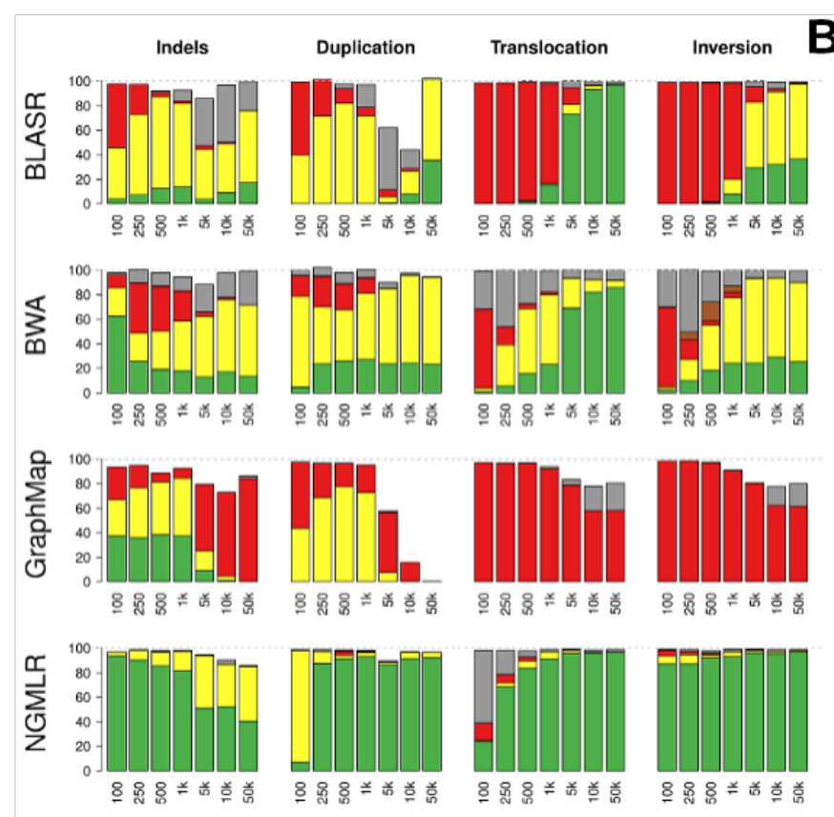
Comparison of aligners (simulated data)
Alignment status: Precise (green), indicated (yellow), forced (red), unaligned reads (white), or trimmed but not aligned through the SV (grey).
Notes:
For read
alignments, we simulated PacBio-like (a) and Oxford Nanopore-like reads (c), and
distinguish between: precise (green), indicated (yellow), forced (red), unaligned reads
(white), or trimmed but not aligned through the SV (grey).

Slide 50
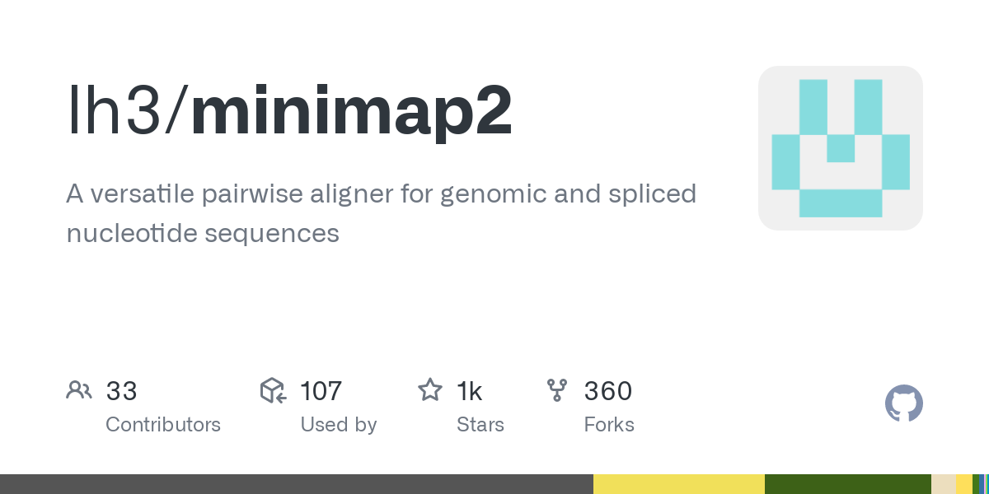
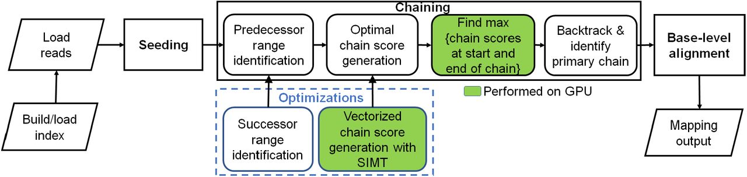
Minimap2 – fast alignment for long reads using Minimizers
What are minimizers?
Reference
K = 15
W = 12
Reads
Find max score

Slide 51
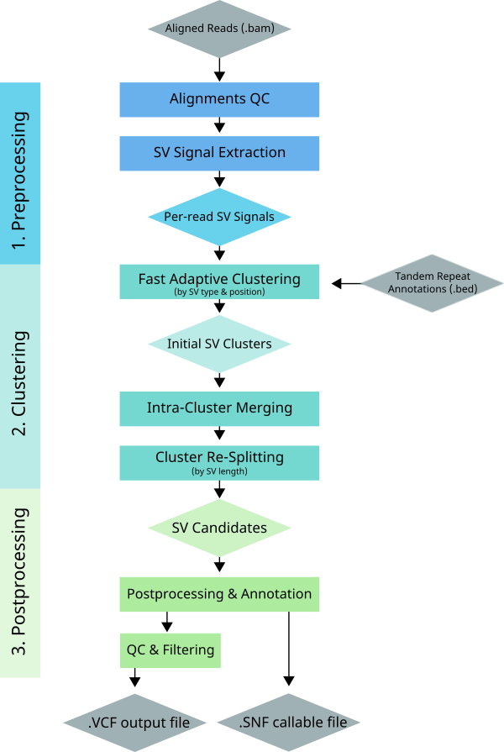
Sniffles and Sniffles2
SV detection from long read alignments
Very fast SV calling using signal extraction,
Followed by clustering and merging
Major new contributions:
Very fast (~20 minutes for 30X genome on CPU)
Somatic long-read SV calling mode
Population-aware SV merging (i.e., joint calling across samples for SVs).
Works well with minimap2 (not just ngmlr)

Slide 52
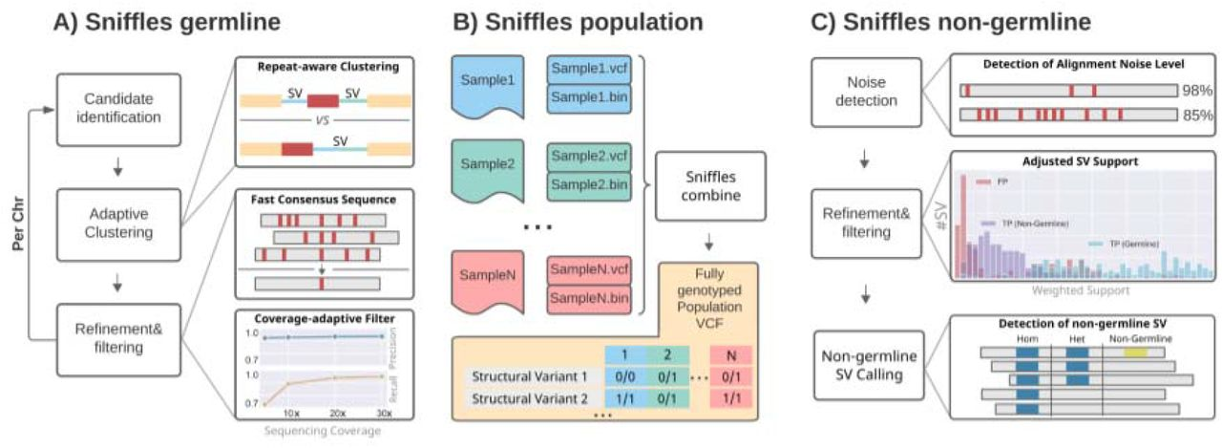
Sniffles and Sniffles2

Slide 53
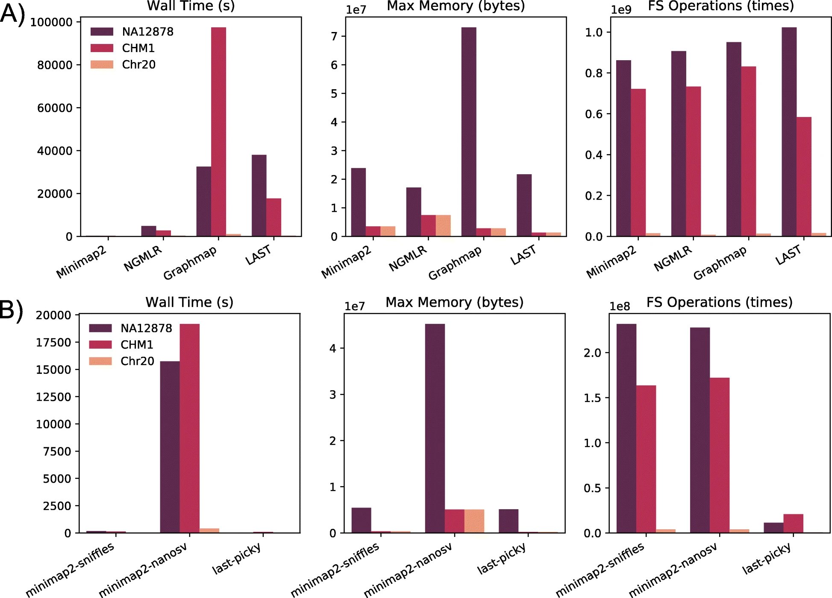
Minimap2 and sniffles
Significant improvement in speed with minimap2; combined with updated sniffles code, significantly faster SV calling for long reads
From: https://genomebiology.biomedcentral.com/articles/10.1186/s13059-019-1858-1

Slide 54
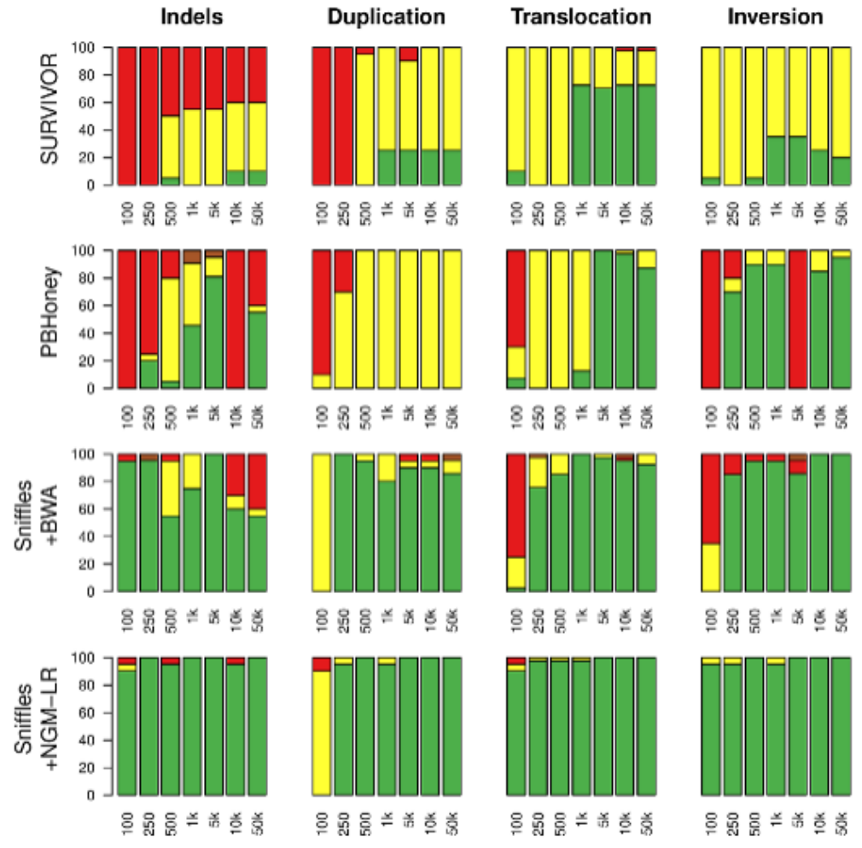
Sniffles performance

Slide 55
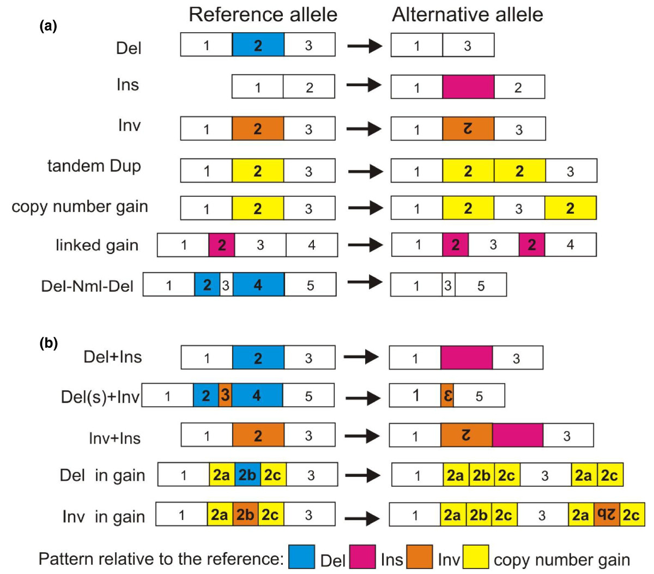
Complex SVs – combinations of our simple SV types
Figure 3. Architecture of structural variants. (a) Simple SVs: deletion (Del), insertion (Ins), inversion (Inv), tandem duplication (tandem Dup) and other types of copy number gains. Linked gain is a small copy number gain at close proximity to its copy. Inverted linked gain (not drawn) is similar to a linked gain but the copy is inverted. Del+Nml+Del is two deletions separated by a normal copy of small size. (b) Complex SVs: deletion co-occurring with insertion (Del+Ins), inversion with flanking deletions (Del(s)+Inv), inversion with insertion (Inv+Ins), deletion within a copy number gain (Del in gain) and inversion within a copy number gain (Inv in gain).
Yalcin et al. (2012) Genome Biology

Slide 56
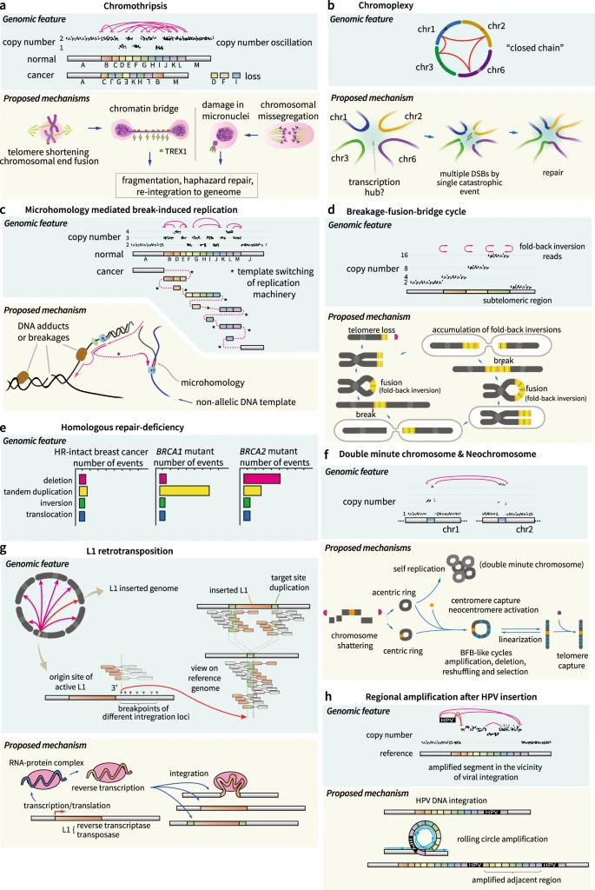
Complex SVs in cancer

Slide 57
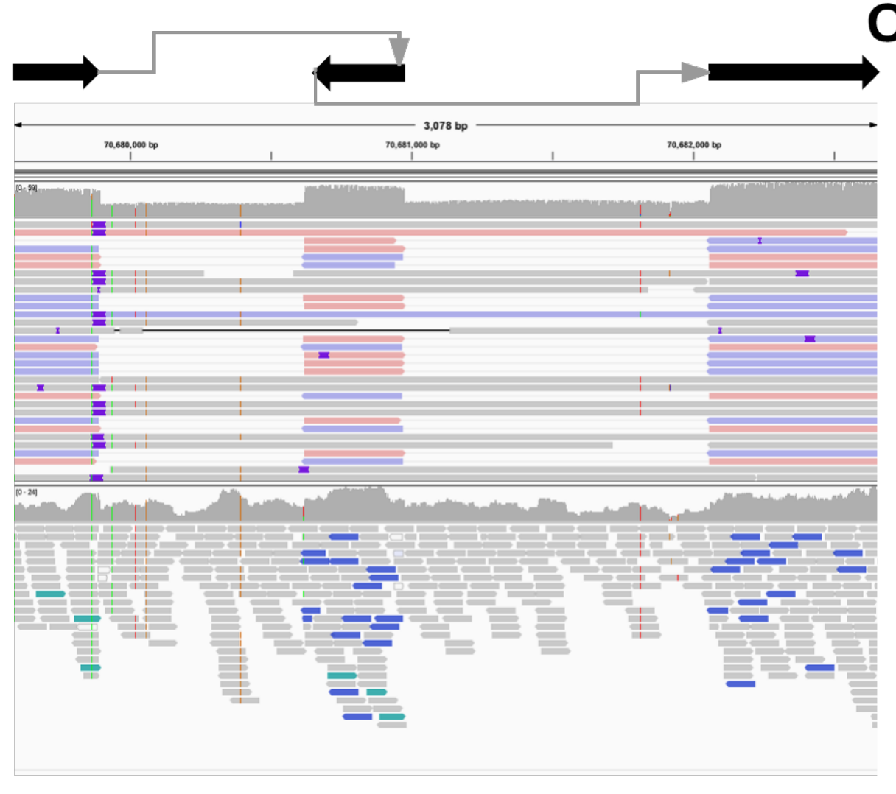
Complex SVs - Long reads
NGLMR
Illumina (BWA-mem)
3kb region: two deletions flanking an inverted sequence

Slide 58
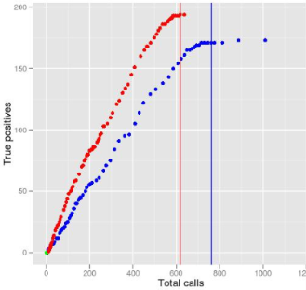
Evaluating SV calls
Specificity vs sensitivity
False positives vs. false negatives
Desirable to have high sensitivity and specificity
How to determine sensitivity?
External sources of true/known SVs
Specificity
Validate a random selection of SVs by another technology
e.g. PCR products
Receiver operator curves to investigate effects of varying parameters

Slide 59
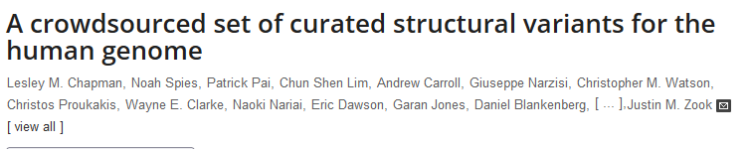

More reading
A robust benchmark for detection of germline large deletions and insertions
10.1038/s41587-020-0538-8
https://doi.org/10.1371/journal.pcbi.1007933
https://doi.org/10.1186/s13059-019-1828-7

Slide 60
Computer exercises
Trivia questions about a VCF output file from the Lumpy SV caller.
http://www.genomebiology.com/2014/15/6/R84
Use the Breakdancer software package to call structural variants on a yeast sample that was paired-end sequenced on the illumina Hiseq.
Use the Lumpy software package to call structural variants on a yeast sample that was paired-end sequenced on the illumina Hiseq.
Call SVs using the Sniffles caller on a yeast sample that was sequenced on the Pacbio platform.
Introduction to BEDtools for doing regional comparisons over genomic co-ordinates.

Slide 61
This slide left blank

Slide 62
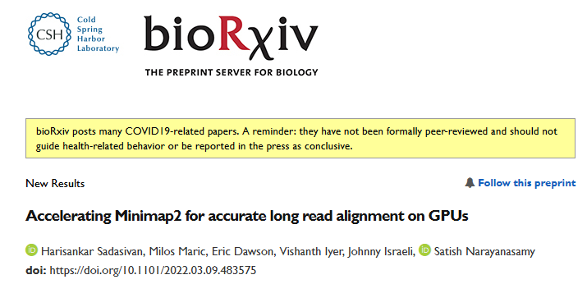
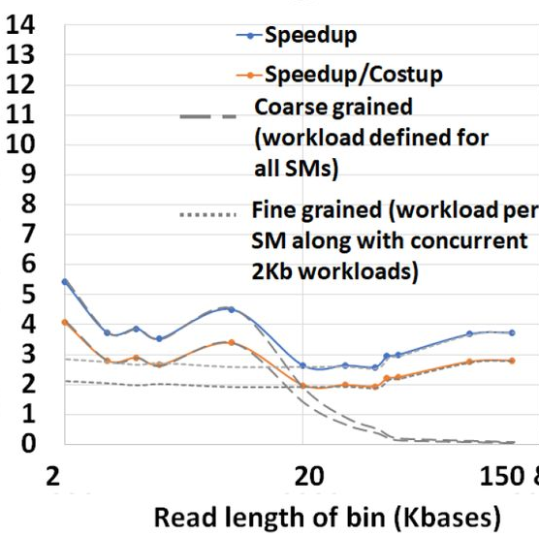
MiniMap2 – GPU Acceleration
Speedup

Slide 63


Complex SV Examples
Yalcin et al. (2012) Genome Biology

